Slide 1


Zomato Restaurant Analysis
Unlocking Insights for Enhanced Dining Experiences
Team Members:
Vijay Manglani
Rajeshwari S
Shivam Shekhar
Parimala
Digavinti Gopi
S.Nancy
Dharmarajan P

Slide 2
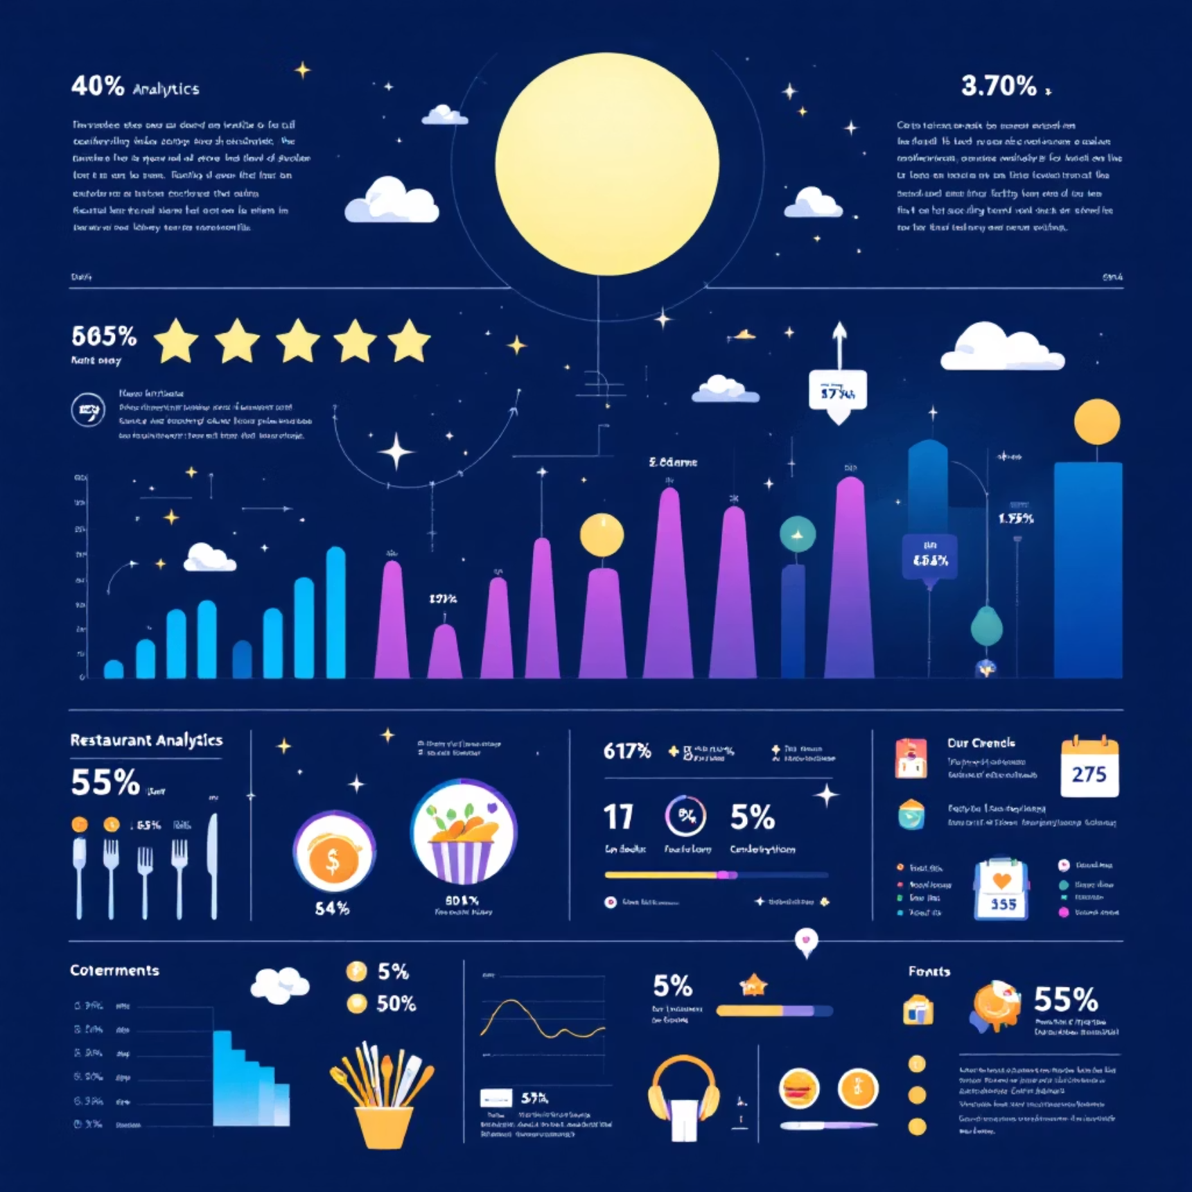
Project Overview: Unveiling Zomato's Landscape
This comprehensive project delves into Zomato's vast restaurant data to illuminate customer preferences, gauge restaurant
performance, and discern critical market trends.
Our analysis spans crucial metrics, including:
Ratings & Pricing: Understanding value and satisfaction.
Cuisines: Exploring diverse culinary landscapes.
Online Delivery & Table Booking: Assessing service impact.
Interactive dashboards translate complex data into actionable insights, empowering data-driven decisions for Zomato's strategic growth.

Slide 3
Strategic Objectives of Zomato Analytics
Our analytical framework is designed to drive targeted improvements and strategic growth for Zomato and its partners.
Performance Across Regions
1
Analyze restaurant performance and popularity across diverse countries and cities to identify growth markets.
Customer Preference Deep Dive
2
Understand dining behavior and preferences through detailed analysis of ratings, votes, and popular cuisines.
Tracking Growth Trajectories
3
Monitor restaurant growth trends across yearly, monthly, and quarterly intervals to forecast market expansion.
Impact of Digital Services
4
Evaluate how online delivery and table booking features influence customer ratings and restaurant success.
Informed Business Decisions
5
Provide robust, data-backed insights to support Zomato's strategic planning and operational enhancements.

Slide 4

Zomato's Current Landscape: Key Performance Indicators
A snapshot of Zomato's extensive network and customer satisfaction metrics.
9,551
$10
2.9/5
Total Restaurants
Avg. Cost for Two
Avg. Restaurant Rating
A vast network of dining options on the platform.
Affordable dining options are prevalent across the platform.
Indicates significant room for service quality and customer satisfaction improvements.
Zomato boasts a substantial restaurant base with budget-friendly options, however, the overall average rating highlights potential areas for enhancing service quality and customer dining experiences.

Slide 5




Online Delivery & Table Booking: Unexplored Potential
Analysis reveals a significant untapped market for digital service adoption among Zomato's restaurant partners.
12%
26%
Table Booking
Online Delivery
Restaurants offering table booking.
Restaurants offering online delivery.
88%
74%
No Table Booking
No Online Delivery
Restaurants not offering table booking.
Restaurants not offering online delivery.
The data indicates that a large majority of restaurants on the platform currently do not provide table booking or online delivery services. This presents a strong opportunity for Zomato to expand its platform offerings and onboard more partners, driving increased customer engagement and convenience.

Slide 6




Cuisine Landscape: Diverse Tastes and Popular Choices
Exploring the culinary preferences of Zomato users reveals a rich tapestry of popular and emerging cuisines.
North Indian Dominance
Fast Food & Chinese Popularity
Bakery & Dessert Performance
High Cuisine Diversity
The platform boasts a broad spectrum of cuisines, catering to a wide array of customer preferences and encouraging culinary exploration.
North Indian cuisine holds the largest share of restaurants, indicating its widespread popularity.
Fast Food and Chinese cuisines are consistently among the most highly patronized options on the platform.
These categories maintain moderate but steady ratings, suggesting a dedicated customer base.

Slide 7

Restaurant Growth Trends: A Decade of Expansion
Zomato has witnessed robust expansion, particularly in recent years, driven by urban centers and strategic quarterly surges.
Consistent Growth: 2010-2018
A steady increase in new restaurant registrations, laying the foundation for platform expansion.
Recent Peak Growth
Accelerated growth in the most recent periods, reflecting increased market penetration and demand.
Q3's Dominance in Openings
The third quarter consistently records the highest number of new restaurant openings, possibly linked to seasonal demand or strategic onboarding initiatives.
Urban Expansion Drivers
Major urban cities are the primary contributors to restaurant expansion, highlighting their role as key growth engines for Zomato.

Slide 8
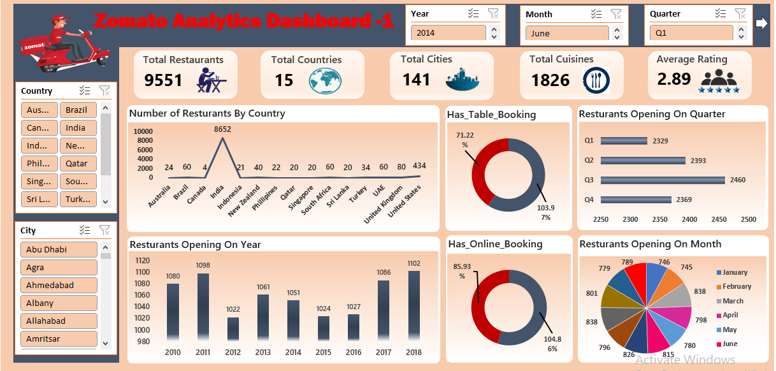

Excel Dashboard - 1
1
2
3
4
5

Slide 9
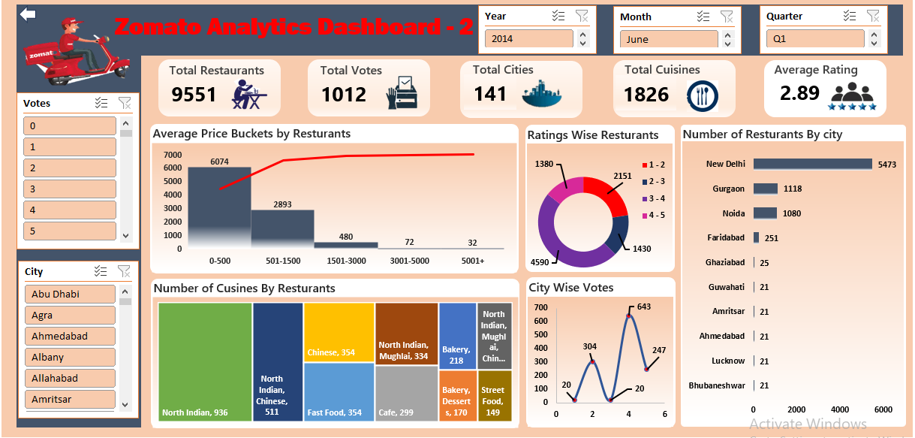
Excel Dashboard - 2
1
2
3
4
5

Slide 10
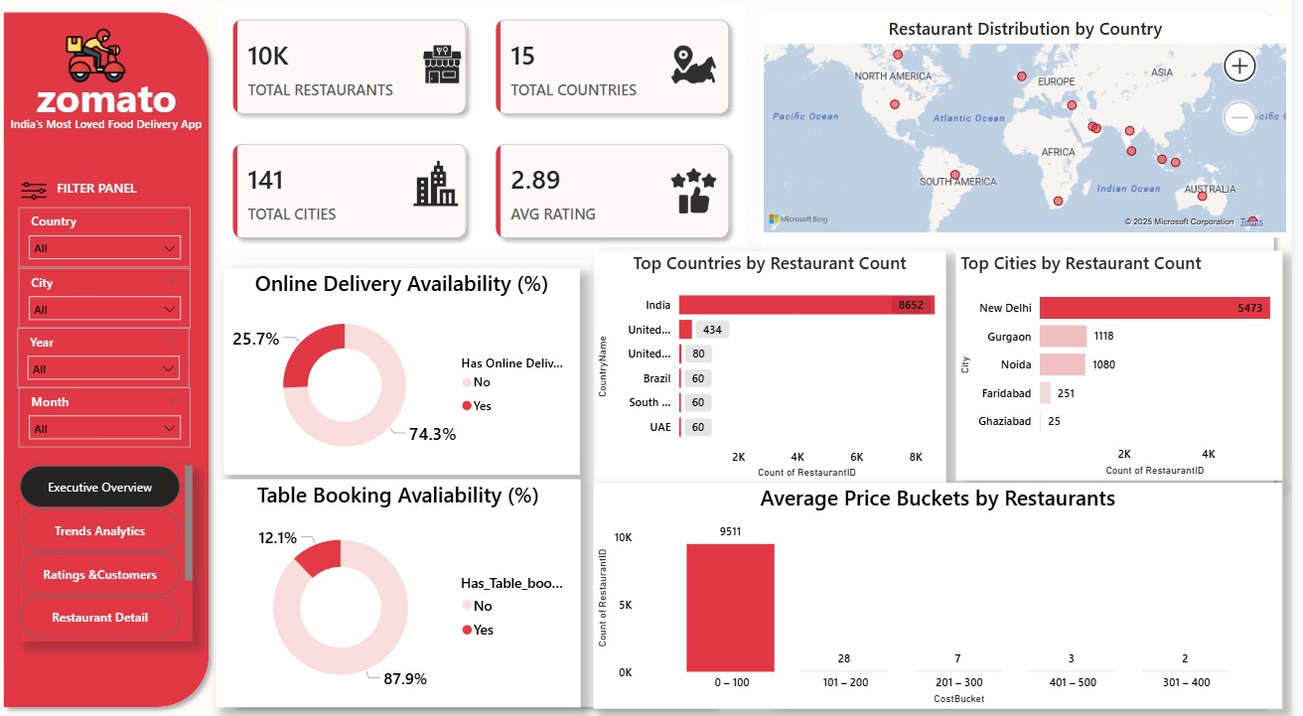
Power BIDashboard-1
1
2
3
4
5

Slide 11
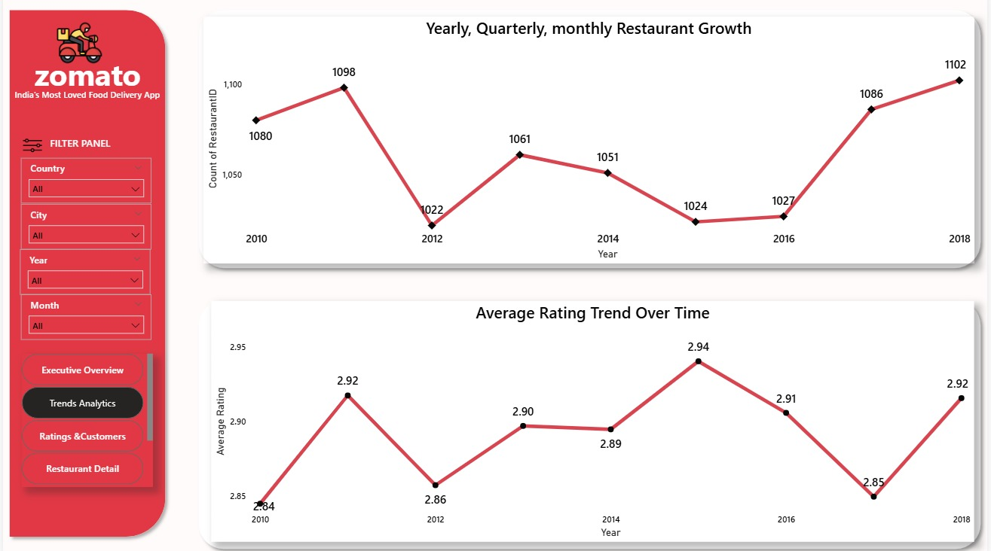
Power BIDashboard-2
1
2
3
4
5

Slide 12
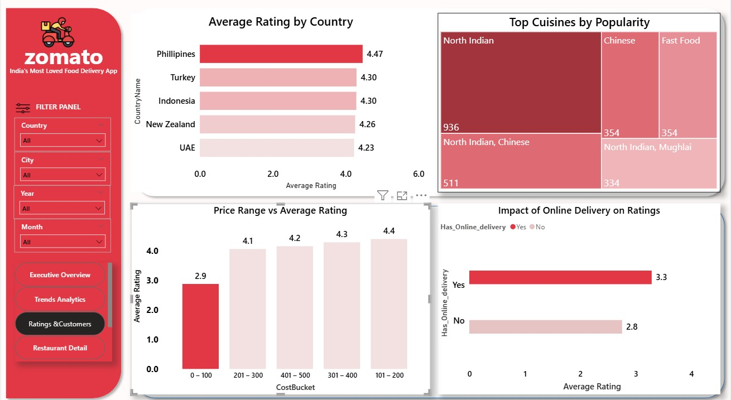
Power BIDashboard-3
1
2
3
4
5

Slide 13
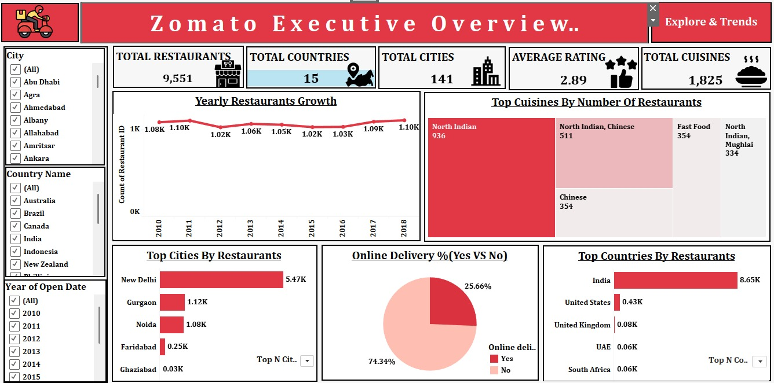
TableauDashboard-1
1
2
3
4
5

Slide 14
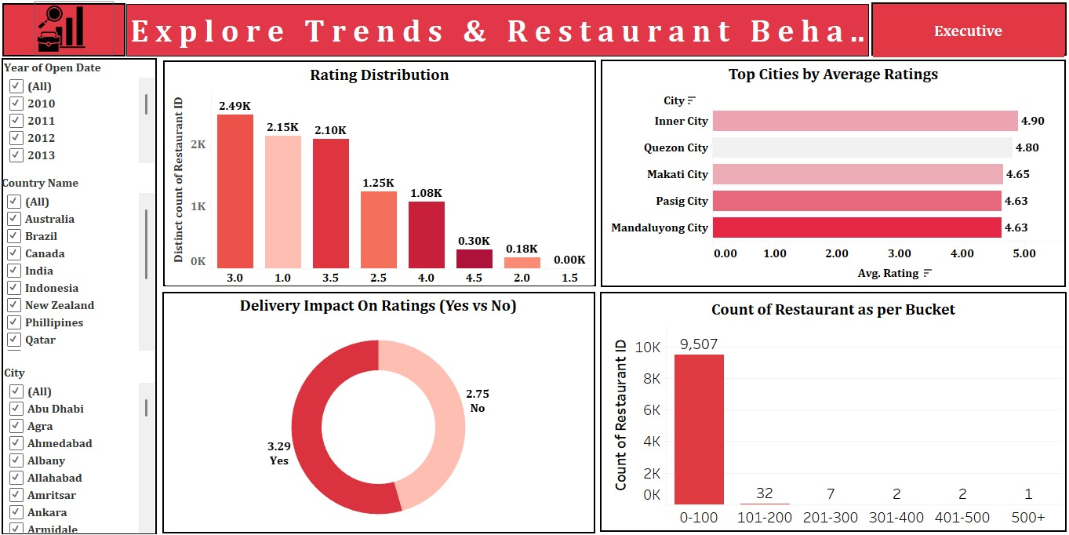
TableauDashboard-2
1
2
3
4
5

Slide 15
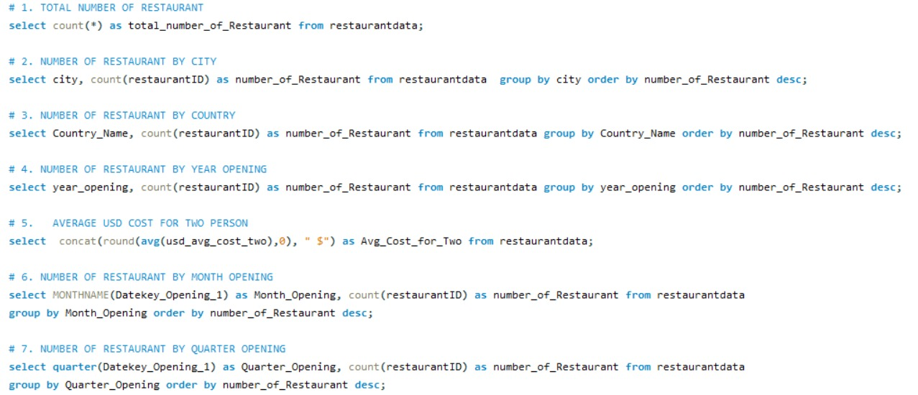
SQL Queries
1
2
3
4
5

Slide 16
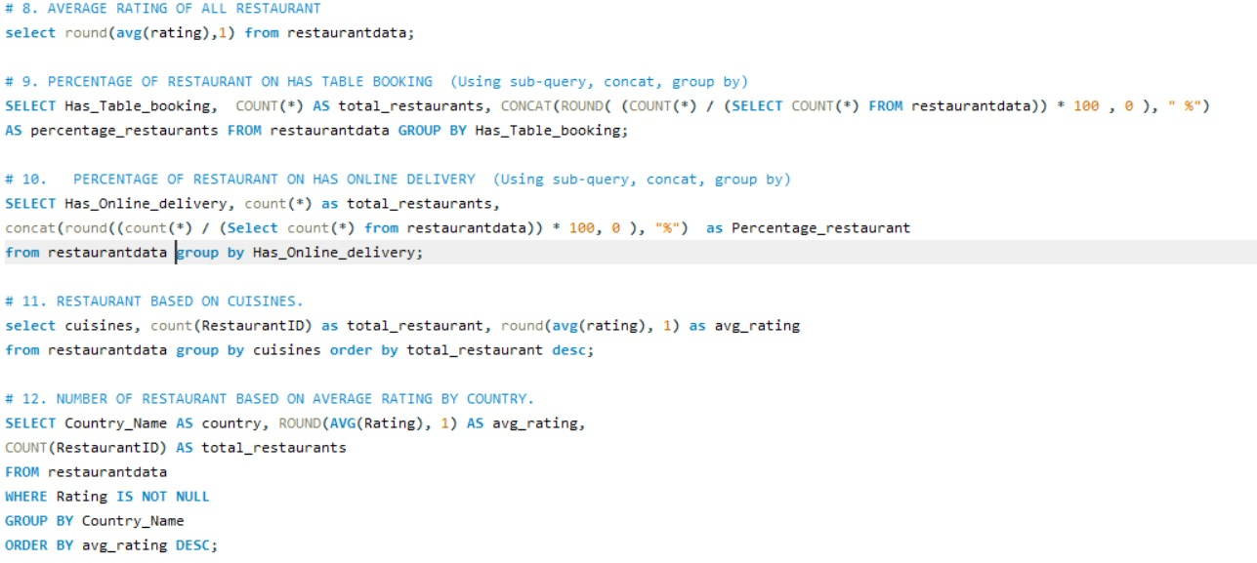
SQL Queries
1
2
3
4
5

Slide 17

Dashboard Insights: Illuminating Zomato's Ecosystem
Our interactive dashboards reveal critical patterns and trends shaping the Zomato experience.
Dominant Rating Range
The majority of restaurants fall within the 3.0–3.9 rating bracket, indicating a broad base of moderately performing establishments.
India's Restaurant Density
India consistently shows the highest number of restaurants, underscoring its pivotal role in Zomato's global presence.
Prevalence of Affordable Dining
Low-cost restaurants (priced at or below $50 for two) form the backbone of the platform's offerings.
Online Delivery's Rating Boost
Restaurants offering online delivery services consistently achieve higher average customer ratings.
Table Booking's Positive Impact
The option for table booking significantly correlates with improved customer satisfaction and ratings.

Slide 18
Navigating the Data Landscape: Analysis Challenges
Undertaking a comprehensive analysis of Zomato's diverse dataset presented several intricate challenges.
1
2
3
Currency Conversion Complexities
Multi-Dimensional Data Integration
Inconsistent Data Formats
Addressing disparities in pricing and currency formats across different entries demanded extensive data cleaning and harmonization.
Managing and standardizing financial data across various international currencies posed a significant hurdle.
Integrating and synthesizing a large dataset with multiple dimensions (country, city, cuisine) required robust data modeling.
4
5
Large File Management in MySQL
Dashboard Performance & Clarity
Importing and processing exceptionally large datasets into MySQL necessitated optimized database strategies.
Ensuring the resulting interactive dashboards were not only performant but also clear and intuitive for users was paramount.

Slide 19
Strategic Recommendations for Zomato's Future
To capitalize on market opportunities and enhance user experience, we recommend focusing on these key
strategic areas:
Boost Online Delivery Adoption
Enhance Table Booking Promotion
Targeted Cuisine Marketing
Direct marketing efforts towards high-performing and popular cuisines to attract and retain a larger customer base.
Actively encourage more restaurants to integrate online delivery services to broaden customer reach and convenience.
Increase awareness and usage of the table booking feature, which has been shown to significantly improve customer satisfaction.
Quality Improvement Initiatives
Strategic Market Expansion
Implement quality audits and support programs for low-rated restaurants to elevate their service standards and customer feedback.
Prioritize expansion into high-growth cities and regions to capture new markets and consolidate Zomato's presence.

Slide 20
THANK YOU

